Slide 1
Introduction to Data Mining

Slide 2
Data Mining
Data mining is a rapidly growing field of business analytics focused on better understanding of characteristics and patterns among variables in large data sets.
It is used to identify and understand hidden patterns that large data sets may contain.
It involves both descriptive and prescriptive analytics, though it is primarily prescriptive.

Slide 3
The Scope of Data Mining
Some common approaches to data mining
Association
- analyze data to identify natural associations among variables and create rules for target marketing or buying recommendations
Netflix uses association to understand what types of movies a customer likes and provides recommendations based on the data
Amazon makes recommendations based on past purchases
Supermarket loyalty cards collect data on customer purchase habits and print coupons based on what was currently bought.

Slide 4
The Scope of Data Mining
Some common approaches to data mining
Clustering
Similar to classification, but when no groups have been defined; finds groupings within data
Example: Insurance company could use clustering to group clients by their age, location and types of insurance purchased.
The categories are unspecified and this is referred to as ‘unsupervised learning’

Slide 5
The Scope of Data Mining
Some common approaches to data mining
Classification
- analyze data to predict how to classify new
elements
Spam filtering in email by examining textural characteristics of message
Help predict if credit-card transaction may be fraudulent
Is a loan application high risk
Will a consumer respond to an ad

Slide 6
Association Rule Mining
Association Rule Mining (affinity analysis)
Seeks to uncover associations in large data sets
Association rules identify attributes that occur together frequently in a given data set.
Market basket analysis, for example, is used determine groups of items consumers tend to purchase together.
Association rules provide information in the form of if-then (antecedent-consequent) statements.
The rules are probabilistic in nature.

Slide 7
Association Rule Mining
Custom Computer Configuration
(PC Purchase Data)
Suppose we want to know which PC components are often ordered together.
Figure 12.35

Slide 8
Association Rule Mining
Measuring the Strength of Association Rules
Support for the (association) rule is the
percentage (or number) of transactions that
include all items both antecedent and consequent.
Confidence of the (association) rule:
Lift is a ratio of confidence to expected confidence.

Slide 9
Association Rule Mining
Measuring Strength of Association
A supermarket database has 100,000 point-of-sale transactions:
2000 include both A and B items
5000 include C
800 include A, B, and C
Association rule:
If A and B are purchased, then C is also purchased.
Support = 800/100,000 = 0.008
Confidence = 800/2000 = 0.40
Expected confidence = 5000/100,000 = 0.05
Lift = 0.40/0.05 = 8

Slide 10
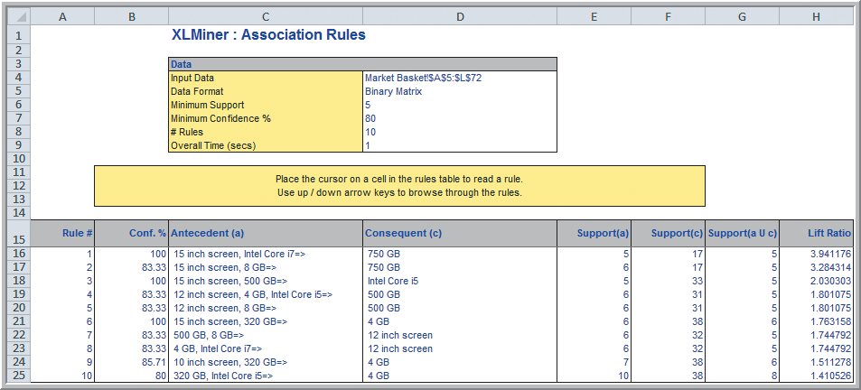
Association Rule Mining
(continued) Identifying Association Rules for PC Purchase Data
Figure 12.37

Slide 11
Association Rule Mining
Example 12.14 (continued) Identifying Association Rules for PC Purchase Data
Figure 12.38
Rules are sorted by their Lift Ratio (how much more likely one is to purchase the consequent if they purchase the antecedents).

Slide 12
Cluster Analysis
Similar to classification, but when no groups have been defined; finds groupings within data
Cluster Analysis has many powerful uses like Market Segmentation.
You can view individual record’s predicted cluster membership.
Also called data segmentation
Two major methods
1. Hierarchical clustering
a) Agglomerative methods (used in XLMiner)
proceed as a series of fusions
2. k-means clustering (available in XLMiner)
partitions data into k clusters so that each element belongs to the cluster with the closest mean

Slide 13
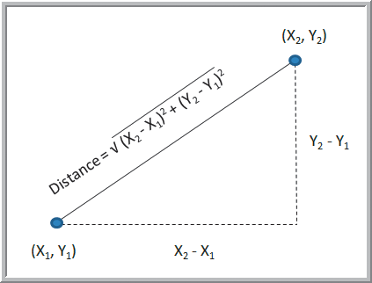
Cluster Analysis – Agglomerative Methods
Dendrogram – a diagram illustrating fusions or divisions at successive stages
Objects “closest” in distance to each other are gradually joined together.
Euclidean distance is
the most commonly
used measure of the
distance between
objects.
Euclidean
Figure 12.2

Slide 14
Clustering Colleges and Universities
Cluster the Colleges and Universities data using the five numeric columns in the data set.
Use the hierarchical method
Figure 12.3

Slide 15
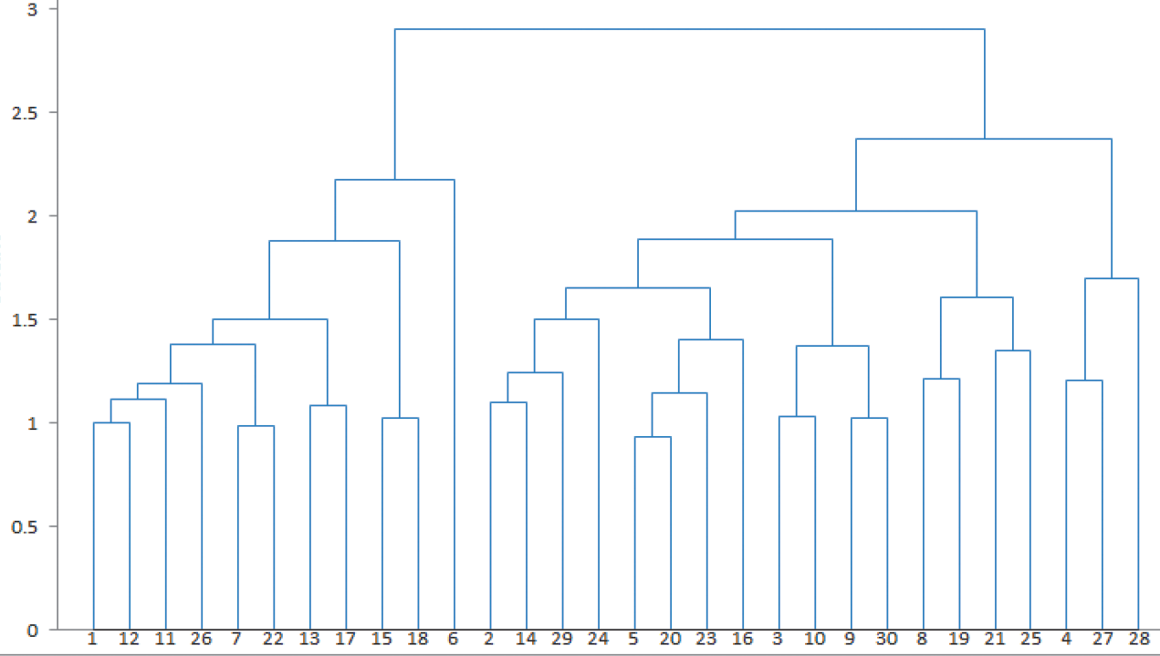
This process of agglomeration leads to the construction of a dendrogram.
This is a tree-like diagram that summarizes the process of clustering.
For any given number of clusters we can determine the records in the clusters by sliding a horizontal line (ruler) up and down the dendrogram until the number of vertical intersections of the horizontal line equals the number of clusters desired.

Slide 16
(continued) Clustering of Colleges
Hierarchical clustering results: Dendrogram
Height of the bars is a measure of dissimilarity in the clusters that are merging into one.
Smaller clusters “agglomerate” into bigger ones, with least possible loss of cohesiveness at each stage.
From Figure 12.8

Slide 17
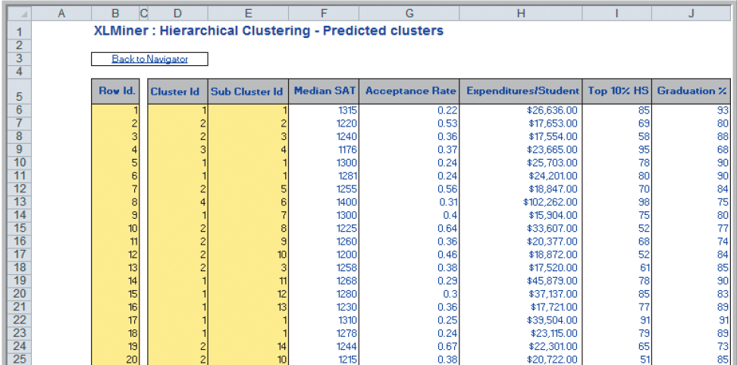
(continued) Clustering of Colleges
Hierarchical clustering results: Predicted clusters
From Figure 12.9

Slide 18
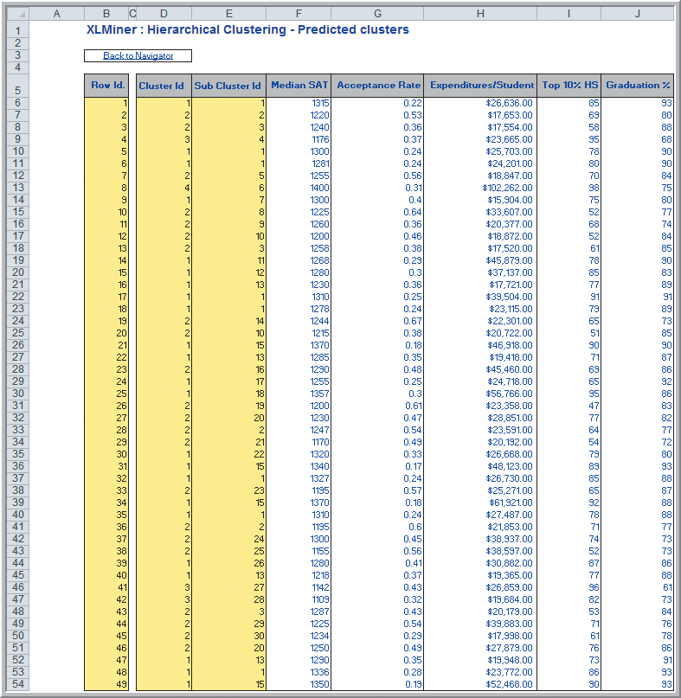
(continued) Clustering of Colleges
Hierarchical clustering results: Predicted clusters
Cluster # Colleges
1 23
2 22
3 3
4 1
Figure 12.9

Slide 19
(continued) Clustering of Colleges
Hierarchical clustering results for clusters 3 and 4
Schools in cluster 3 appear similar.
Cluster 4 has considerably higher Median SAT and Expenditures/Student.

Slide 20
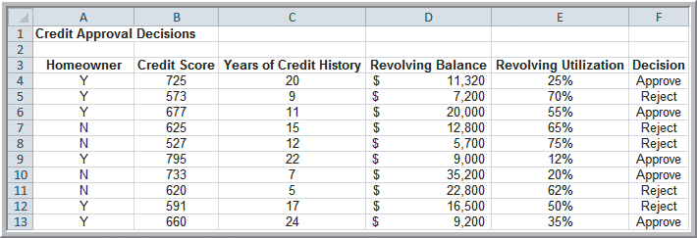
Classification
Recognizes patterns that describe group to which item belongs
We will analyze the Credit Approval Decisions data to predict how to classify new elements.
Categorical variable of interest: Decision (whether to approve or reject a credit application)
Predictor variables: shown in columns A-E
Figure 12.10

Slide 21
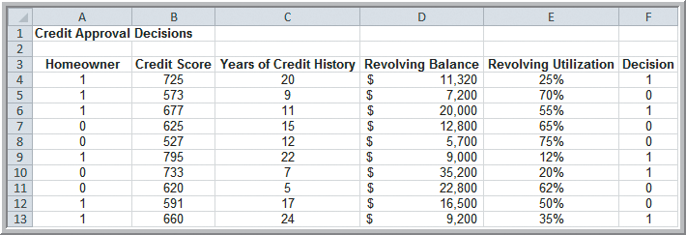
Classification
Modified Credit Approval Decisions
The categorical variables are coded as numeric:
Homeowner - 0 if No, 1 if Yes
Decision - 0 if Reject, 1 if Approve
Figure 12.11

Slide 22
Classification
Using Training and Validation Data
Data mining projects typically involve large volumes of data.
The data can be partitioned into:
training data set – has known outcomes and is used to “teach” the data-mining algorithm
validation data set – used to fine-tune a model
test data set – tests the accuracy of the model
In XLMiner, partitioning can be random or user-specified.

Slide 23
Classification
(continued) Partitioning Data Sets in XLMiner
Partitioning choices when choosing random
Automatic 60% training, 40% validation
Specify % 50% training, 30% validation, 20% test (training and validation % can be modified)
Equal # records 33.33% training, validation, test
XLMiner has size and relative size limitations on the data sets, which can affect the amount and % of data assigned to the data sets.

Slide 24
Classification Techniques
Three Data-Mining Approaches to Classification:
1. k-Nearest Neighbors (k-NN) Algorithm
find records in a database that have similar numerical values of a set of predictor variables
2. Discriminant Analysis (what we will do)
use predefined classes based on a set of linear discriminant functions of the predictor variables
3. Logistic Regression
estimate the probability of belonging to a category using a regression on the predictor variables

Slide 25
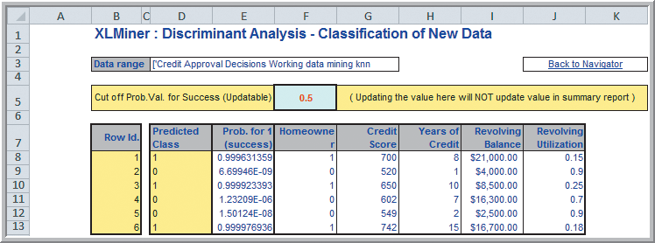
Classification Techniques
(continued) Using Discriminant Analysis for Classifying New Data
Figure 12.27
Half of the applicants are in the “Approved” class

